Slide 1


Slide 2
1 Chronicles 3:10-12 Matthew 1:8-9
Asa Asa
Jehoshaphat Jehoshaphat
Joram Joram
Ahaziah (Uzziah) Uzziah
Joash
Amaziah
Azariah
Jotham Jotham
Ahaz Ahaz
Hezekiah Hezekiah

Slide 4
Genesis 1
1 In the beginning God created the heavens and the earth. 2 The earth was formless and void, and darkness was over the surface of the deep, and the Spirit of God was moving over the surface of the waters.
3 Then God said, “Let there be light”; and there was light. 4 God saw that the light was good; and God separated the light from the darkness. 5 God called the light day, and the darkness He called night. And there was evening and there was morning, one day.
Gap Theory
Light

Slide 5
6 Then God said, “Let there be an expanse in the midst of the waters, and let it separate the waters from the waters.” 7 God made the expanse, and separated the waters which were below the expanse from the waters which were above the expanse; and it was so. 8 God called the expanse heaven. And there was evening and there was morning, a second day.
Separated Water

Slide 6
9 Then God said, “Let the waters below the heavens be gathered into one place, and let the dry land appear”; and it was so. 10 God called the dry land earth, and the gathering of the waters He called seas; and God saw that it was good. 11 Then God said, “Let the earth sprout vegetation, plants yielding seed, and fruit trees on the earth bearing fruit after their kind with seed in them”; and it was so. 12 The earth brought forth vegetation, plants yielding seed after their kind, and trees bearing fruit with seed in them, after their kind; and God saw that it was good. 13 There was evening and there was morning, a third day.
Dry Land
Vegetation

Slide 7
14 Then God said, “Let there be lights in the expanse of the heavens to separate the day from the night, and let them be for signs and for seasons and for days and years; 15 and let them be for lights in the expanse of the heavens to give light on the earth”; and it was so. 16 God made the two great lights, the greater light to govern the day, and the lesser light to govern the night; He made the stars also. 17 God placed them in the expanse of the heavens to give light on the earth, 18 and to govern the day and the night, and to separate the light from the darkness; and God saw that it was good. 19 There was evening and there was morning, a fourth day.
Sun, Moon Stars
How was evening and morning marked before this day?

Slide 8
20 Then God said, “Let the waters teem with swarms of living creatures, and let birds fly above the earth in the open expanse of the heavens.” 21 God created the great sea monsters and every living creature that moves, with which the waters swarmed after their kind, and every winged bird after its kind; and God saw that it was good. 22 God blessed them, saying, “Be fruitful and multiply, and fill the waters in the seas, and let birds multiply on the earth.” 23 There was evening and there was morning, a fifth day.
Fish & Birds

Slide 9
24 Then God said, “Let the earth bring forth living creatures after their kind: cattle and creeping things and beasts of the earth after their kind”; and it was so. 25 God made the beasts of the earth after their kind, and the cattle after their kind, and everything that creeps on the ground after its kind; and God saw that it was good.
26 Then God said, “Let Us make man in Our image, according to Our likeness; and let them rule over the fish of the sea and over the birds of the sky and over the cattle and over all the earth, and over every creeping thing that creeps on the earth.” 27 God created man in His own image, in the image of God He created him; male and female He created them. 28 God blessed them; and God said to them, “Be fruitful and multiply, and fill the earth, and subdue it; and rule over the fish of the sea and over the birds of the sky and over every living thing that moves on the earth.
Animals,
Man &
Woman

Slide 10
” 29 Then God said, “Behold, I have given you every plant yielding seed that is on the surface of all the earth, and every tree which has fruit yielding seed; it shall be food for you; 30 and to every beast of the earth and to every bird of the sky and to every thing that moves on the earth which has life, I have given every green plant for food”; and it was so. 31 God saw all that He had made, and behold, it was very good. And there was evening and there was morning, the sixth day.

Slide 11
Genesis 2
1 Thus the heavens and the earth were completed, and all their hosts. 2 By the seventh day God completed His work which He had done, and He rested on the seventh day from all His work which He had done. 3 Then God blessed the seventh day and sanctified it, because in it He rested from all His work which God had created and made.
Unfortunate chapter break
Rest

Slide 12
4 This is the account of the heavens and the earth when they were created, in the day that the LORD God made earth and heaven. 5 Now no shrub of the field was yet in the earth, and no plant of the field had yet sprouted, for the LORD God had not sent rain upon the earth, and there was no man to cultivate the ground. 6 But a mist used to rise from the earth and water the whole surface of the ground. 7 Then the LORD God formed man of dust from the ground, and breathed into his nostrils the breath of life; and man became a living being. 8 The LORD God planted a garden toward the east, in Eden; and there He placed the man whom He had formed. 9 Out of the ground the LORD God caused to grow every tree that is pleasing to the sight and good for food; the tree of life also in the midst of the garden, and the tree of the knowledge of good and evil.
Hebrew Word Yom
Man
Vegetation

Slide 13
10 Now a river flowed out of Eden to water the garden; and from there it divided and became four rivers. 11 The name of the first is Pishon; it flows around the whole land of Havilah, where there is gold. 12 The gold of that land is good; the bdellium and the onyx stone are there. 13 The name of the second river is Gihon; it flows around the whole land of Cush. 14 The name of the third river is Tigris; it flows east of Assyria. And the fourth river is the Euphrates.
15 Then the LORD God took the man and put him into the garden of Eden to cultivate it and keep it. 16 The LORD God commanded the man, saying, “From any tree of the garden you may eat freely; 17 but from the tree of the knowledge of good and evil you shall not eat, for in the day that you eat from it you will surely die.”

Slide 14
18 Then the LORD God said, “It is not good for the man to be alone; I will make him a helper suitable for him.” 19 Out of the ground the LORD God formed every beast of the field and every bird of the sky, and brought them to the man to see what he would call them; and whatever the man called a living creature, that was its name. 20 The man gave names to all the cattle, and to the birds of the sky, and to every beast of the field, but for Adam there was not found a helper suitable for him. 21 So the LORD God caused a deep sleep to fall upon the man, and he slept; then He took one of his ribs and closed up the flesh at that place. 22 The LORD God fashioned into a woman the rib which He had taken from the man, and brought her to the man.
Animals
and Birds
Named
Creatures
Woman

Slide 15
23 The man said,
“This is now bone of my bones, And flesh of my flesh; She shall be called Woman, Because she was taken out of Man.”
24 For this reason a man shall leave his father and
his mother, and be joined to his wife; and they shall
become one flesh. 25 And the man and his wife were
both naked and were not ashamed.

Slide 16
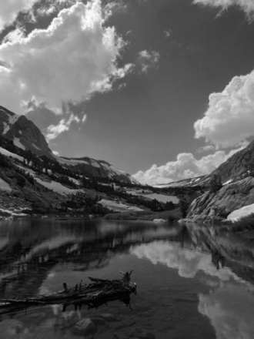
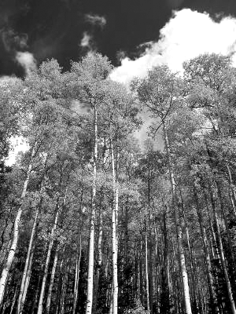
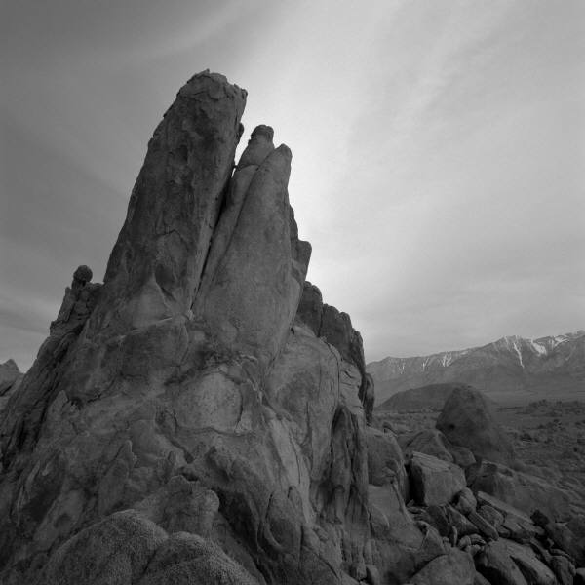
Day does not have to be taken as a literal 24 hour period of time.
- No Sun until day four
- Use of word Yom for period of time.
- Day 5, a lot of stuff takes place

Slide 17
The order of creation is not critical.
-Two back to back accounts show different order
-The structure is one of forming then filling
Days of Forming | Days of Filling
Light | 4. Sun, moon stars
2. Water & Air | 5. Sea Creatures & Birds
3. Earth | 6. Animals & Man

Slide 18
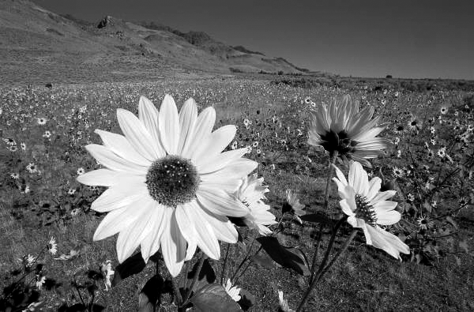
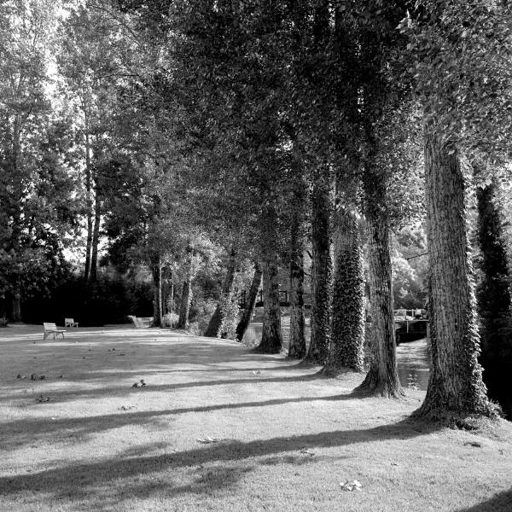
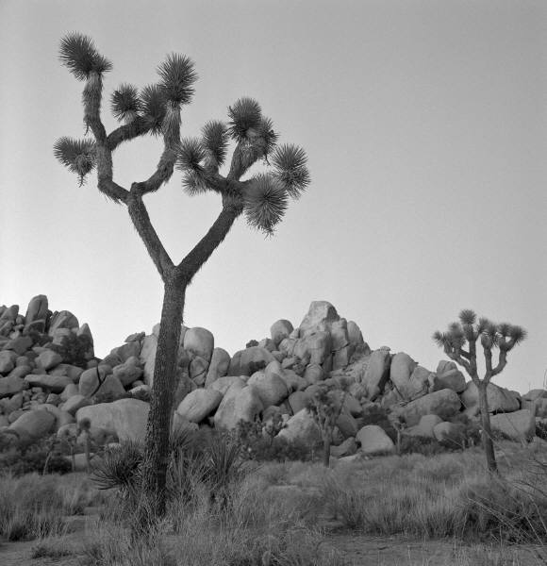
Conclusions
There was a beginning
God created everything from nothing
There was a process

Slide 19
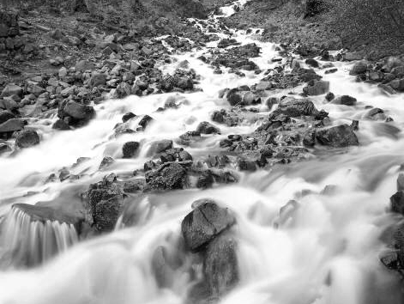
Could God have created the universe in
6 literal periods of 24 hours? YES
Is it compatible with scriptures to
have a longer period of time? YES

Slide 21
Psalms 19:1
The heavens are telling of the glory of God; And their expanse is declaring the work of His hands.
“The most incomprehensible thing about the universe is that it is comprehensible”
-Albert Einstein

Slide 23
“In the end there will be no final conflict between Scripture and Science.”
-Wayne Grudem, Theologian
Phoenix Seminary

Slide 24
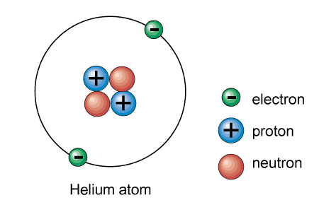

Slide 25
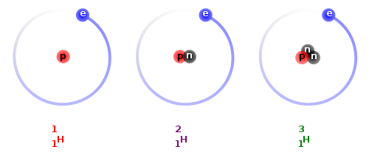
Hydrogen Deutrium Tritrium

Slide 26
Half-Life
The half-life of an isostope is defined as the time it takes for half of the parent isotope to decay into the daughter element.
²³⁸Ur -> ²⁰⁶ Pb 4.5 Billion Years
²³⁵Ur -> ²⁰⁷ Pb 704 Million Years
²³²Th -> ²⁰⁸ Pb 14 Billion Years
⁸⁷Ru -> ⁸⁷ Sr 48.8 Billion Years
⁴⁰K -> ⁴⁰Ar 1.25 Bilion Years
¹⁴C -> ¹⁴ N 5717 Years

Slide 27
Age equation: t = (1/λ) ln [1+ (D/P)]
D = number of atoms of a daughter product
P = number of atoms of a parent product
*determined by a mass spectrometer
λ = decay constant

Slide 29
Conclusions:
1. Is radiometric dating and erosion dating wrong?
NO, but their results require careful INTERPRETAION
2. What do these methods say about the age of the earth?
Ur -> Pb, K -> Ar, and St -> Rb dating all give and age of the earth of 4.55 billion years +/- 1%
3. So either the earth is OLD or it was created with AGE.

Slide 31
Quote from the international press conference announcing the completion of the human genome project.
“Without a doubt, this is the most important, most wonderous map ever produced by mankind. Today we are learning the language in which God created life. We are gaining ever more awe for the complexity, the beauty, and the wonder of God’s most divine and sacred gift.”
                Bill Clinton

Slide 32
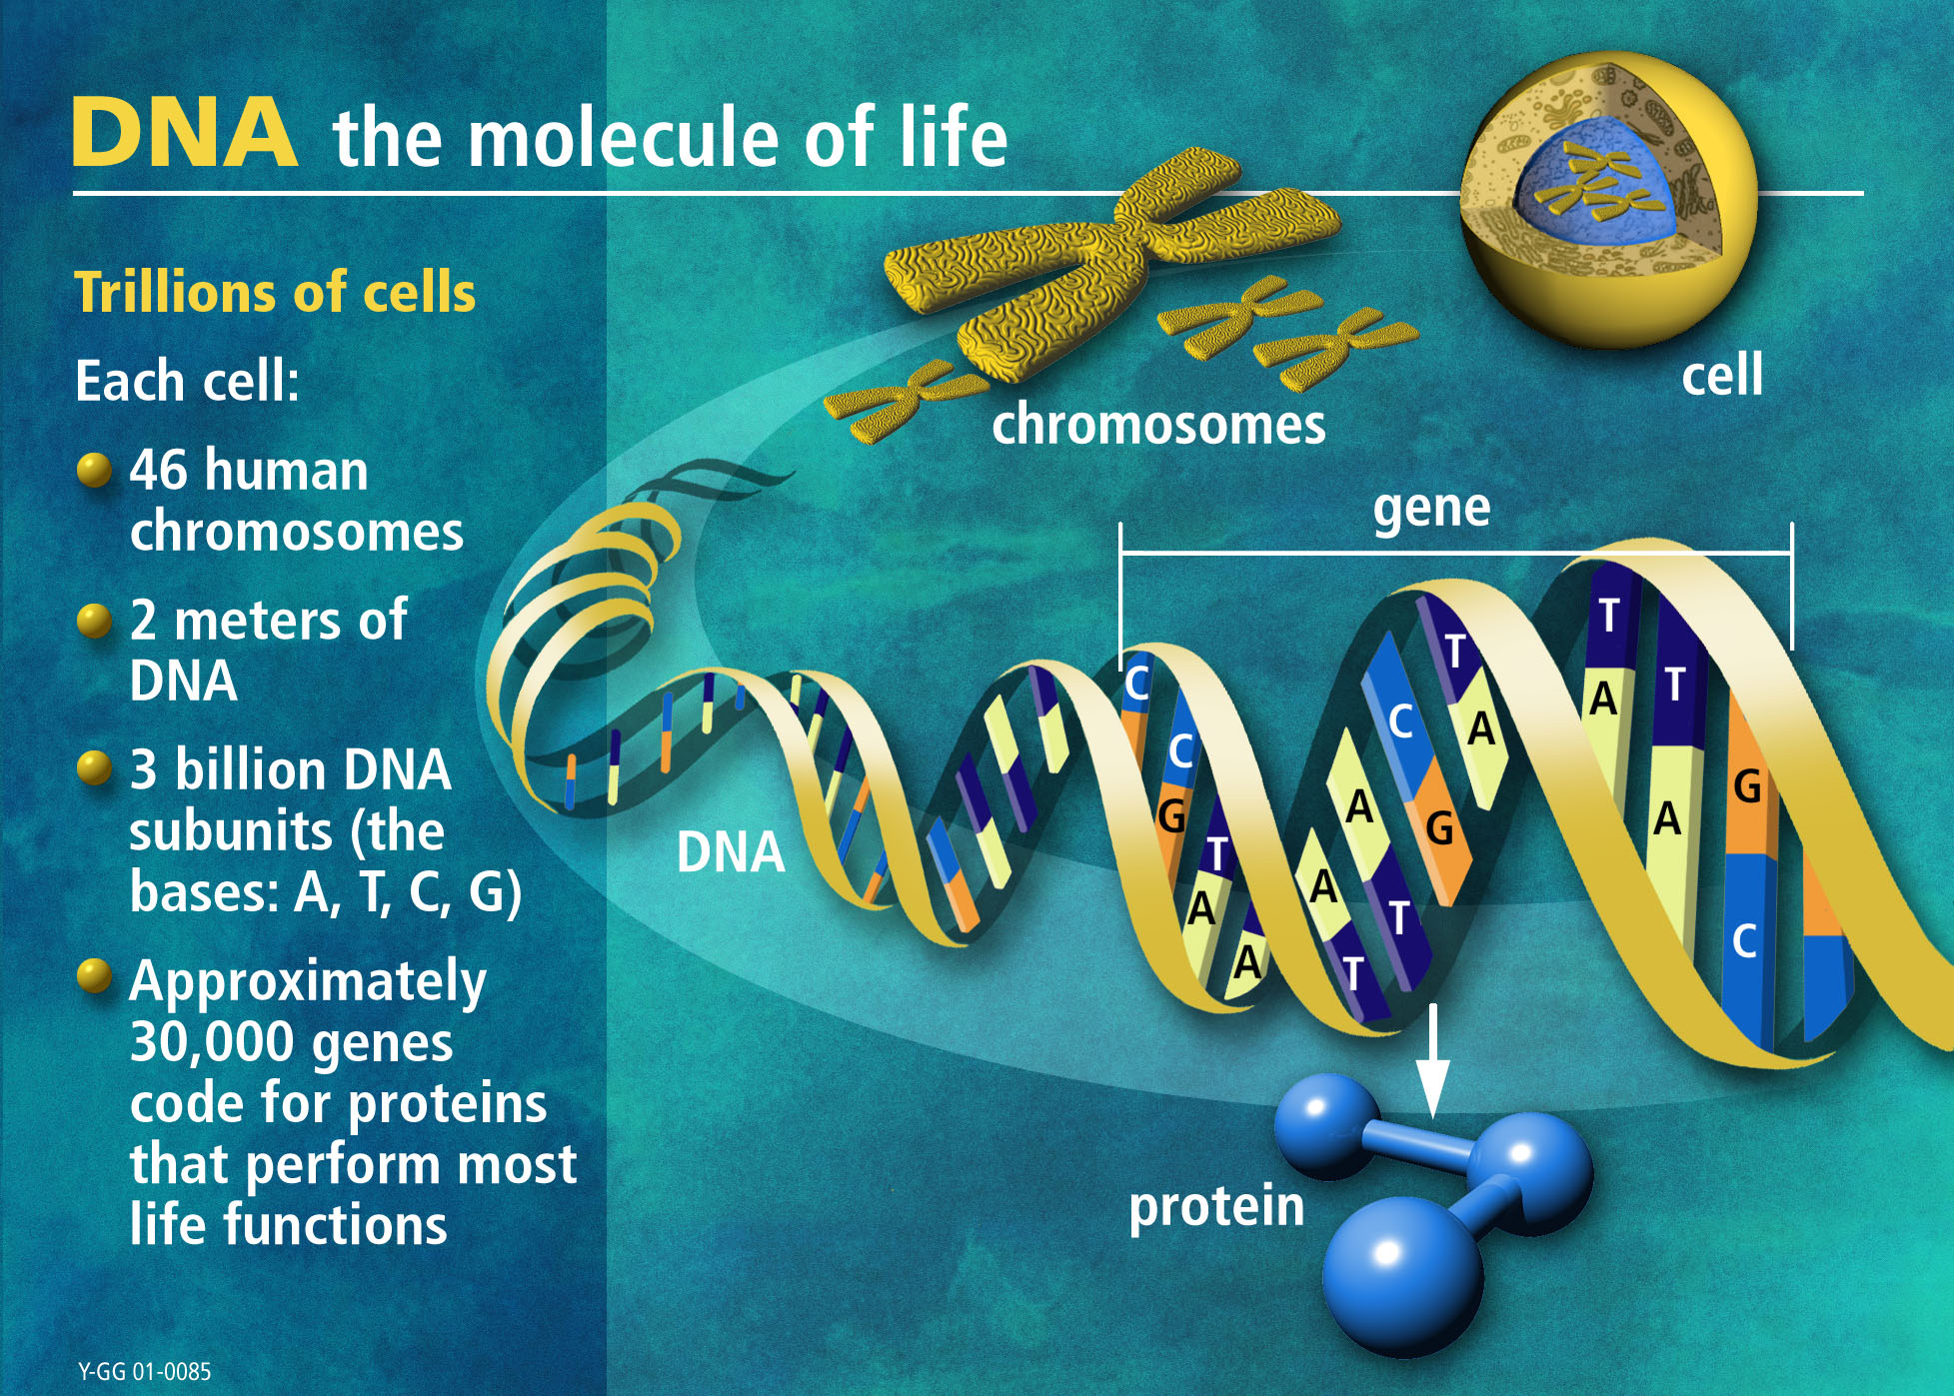

Slide 33
“There is grandeur in this view of life, with its several powers, having been originally breathed by the creator into a few forms or into one; and that, whilist this planet has gone cycling on according to the
fixed law of gravity, from so simple a beginning, endless forms most beautiful and most wonderful
have been, and are being evolved.”
-Charles Darwin
Our study of modern genetics is COMPLIMENTARY to the theory of natural selection. However the evolution of life from chemicals is a significant jump to make.

Slide 35
Big Bang Theory
Prior to the Big Bang Theory of the creation of the universe, the common scientific thought was that we lived in a STATIC universe.
Positives: Big Bang Theory requires a point in time for creation.
Creation come from “nothing”
Sets out a PROCESS of FORMING then FILLING.
Negatives: TIME SCALE

Slide 37
Anthropic Principle
The principle that the universe is fine tuned for life to exist.

Slide 39
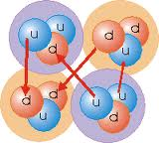
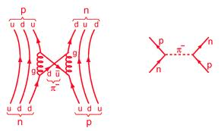

Slide 41
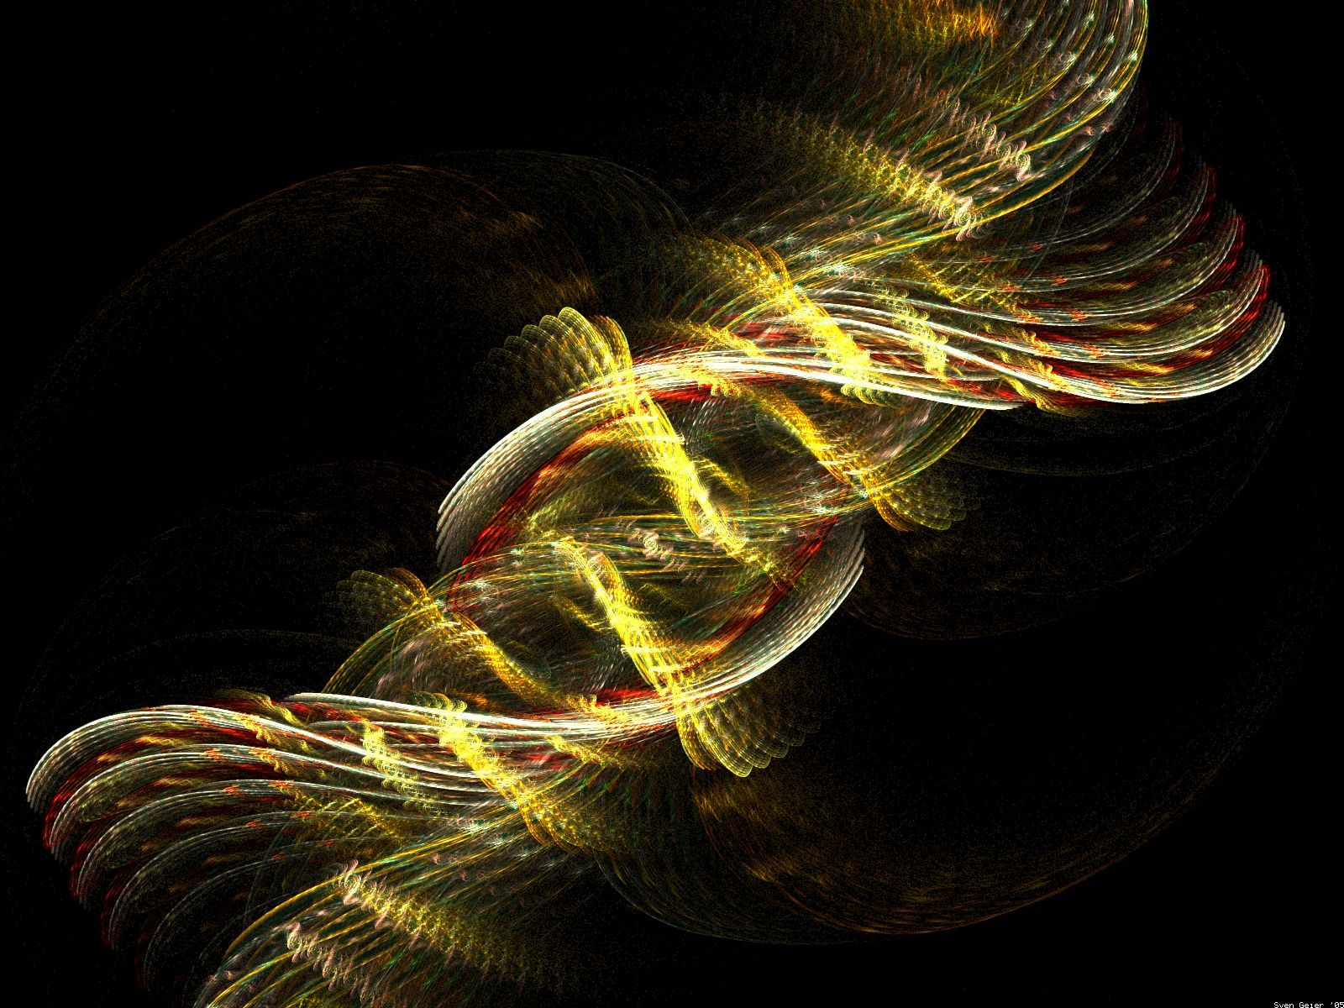

Slide 43
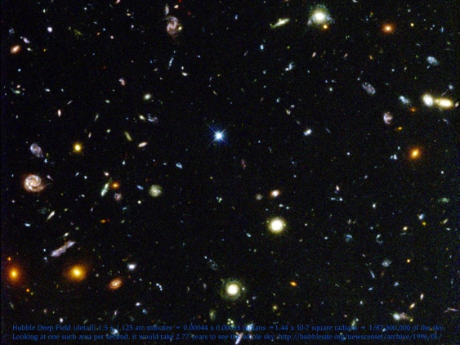

Slide 45
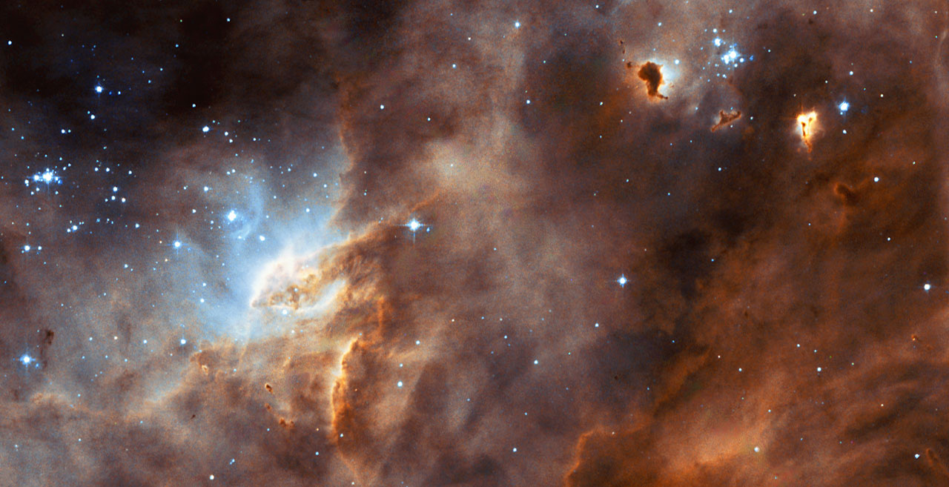

Slide 47
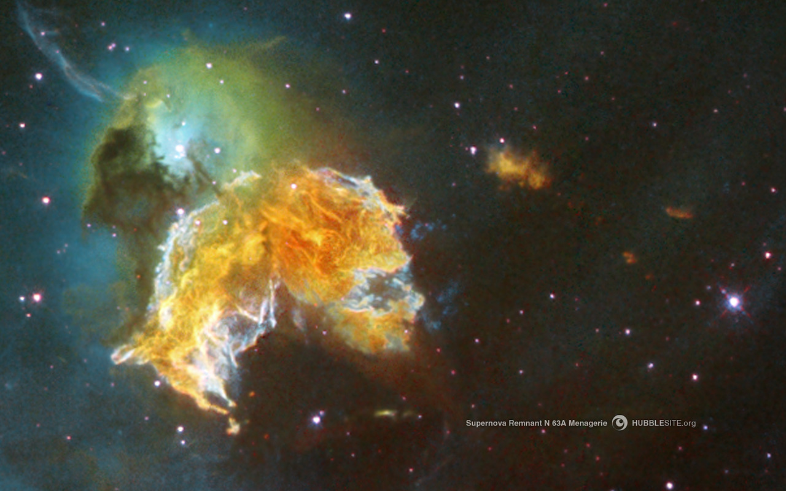

Slide 49
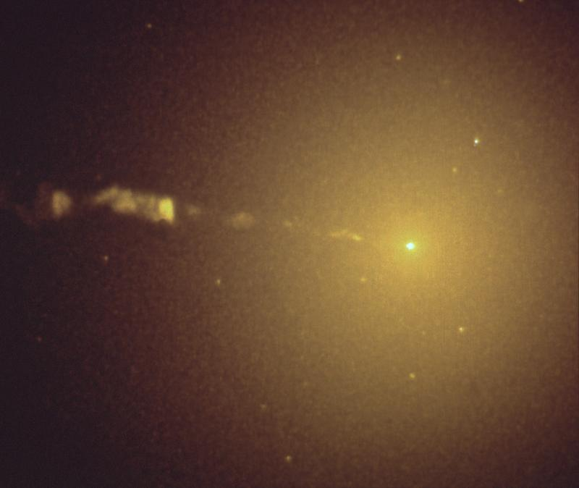

Slide 51
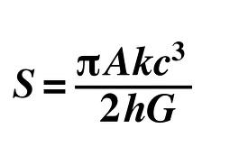
Bekenstein – Hawking Entropy Formula

Slide 52
“It would be very difficult to explain why the Universe should have begun this way, except as an act of God who intended to create beings like us.”
Stephen Hawkings “A Brief History of Time”

